Slide 1

Machine Learning on ARM processors
Module 19 - 20

Slide 2
Machine Learning (ML) on a budget
ML infrastructure has been divided into two parts;
Training of the NN
Inference of the NN (at the “edge”)
Training infrastructure has almost been standardized with combination of CPU (usually Intel Xeon) and GPU (Nvidia)
Till recently training and inference were both done using the cloud infrastructure
With sharp increase in the number of edge devices deployed and the general trend of making them “smart devices” using ML techniques, cloud based inference solution would increase latency to unacceptable limits

Slide 3
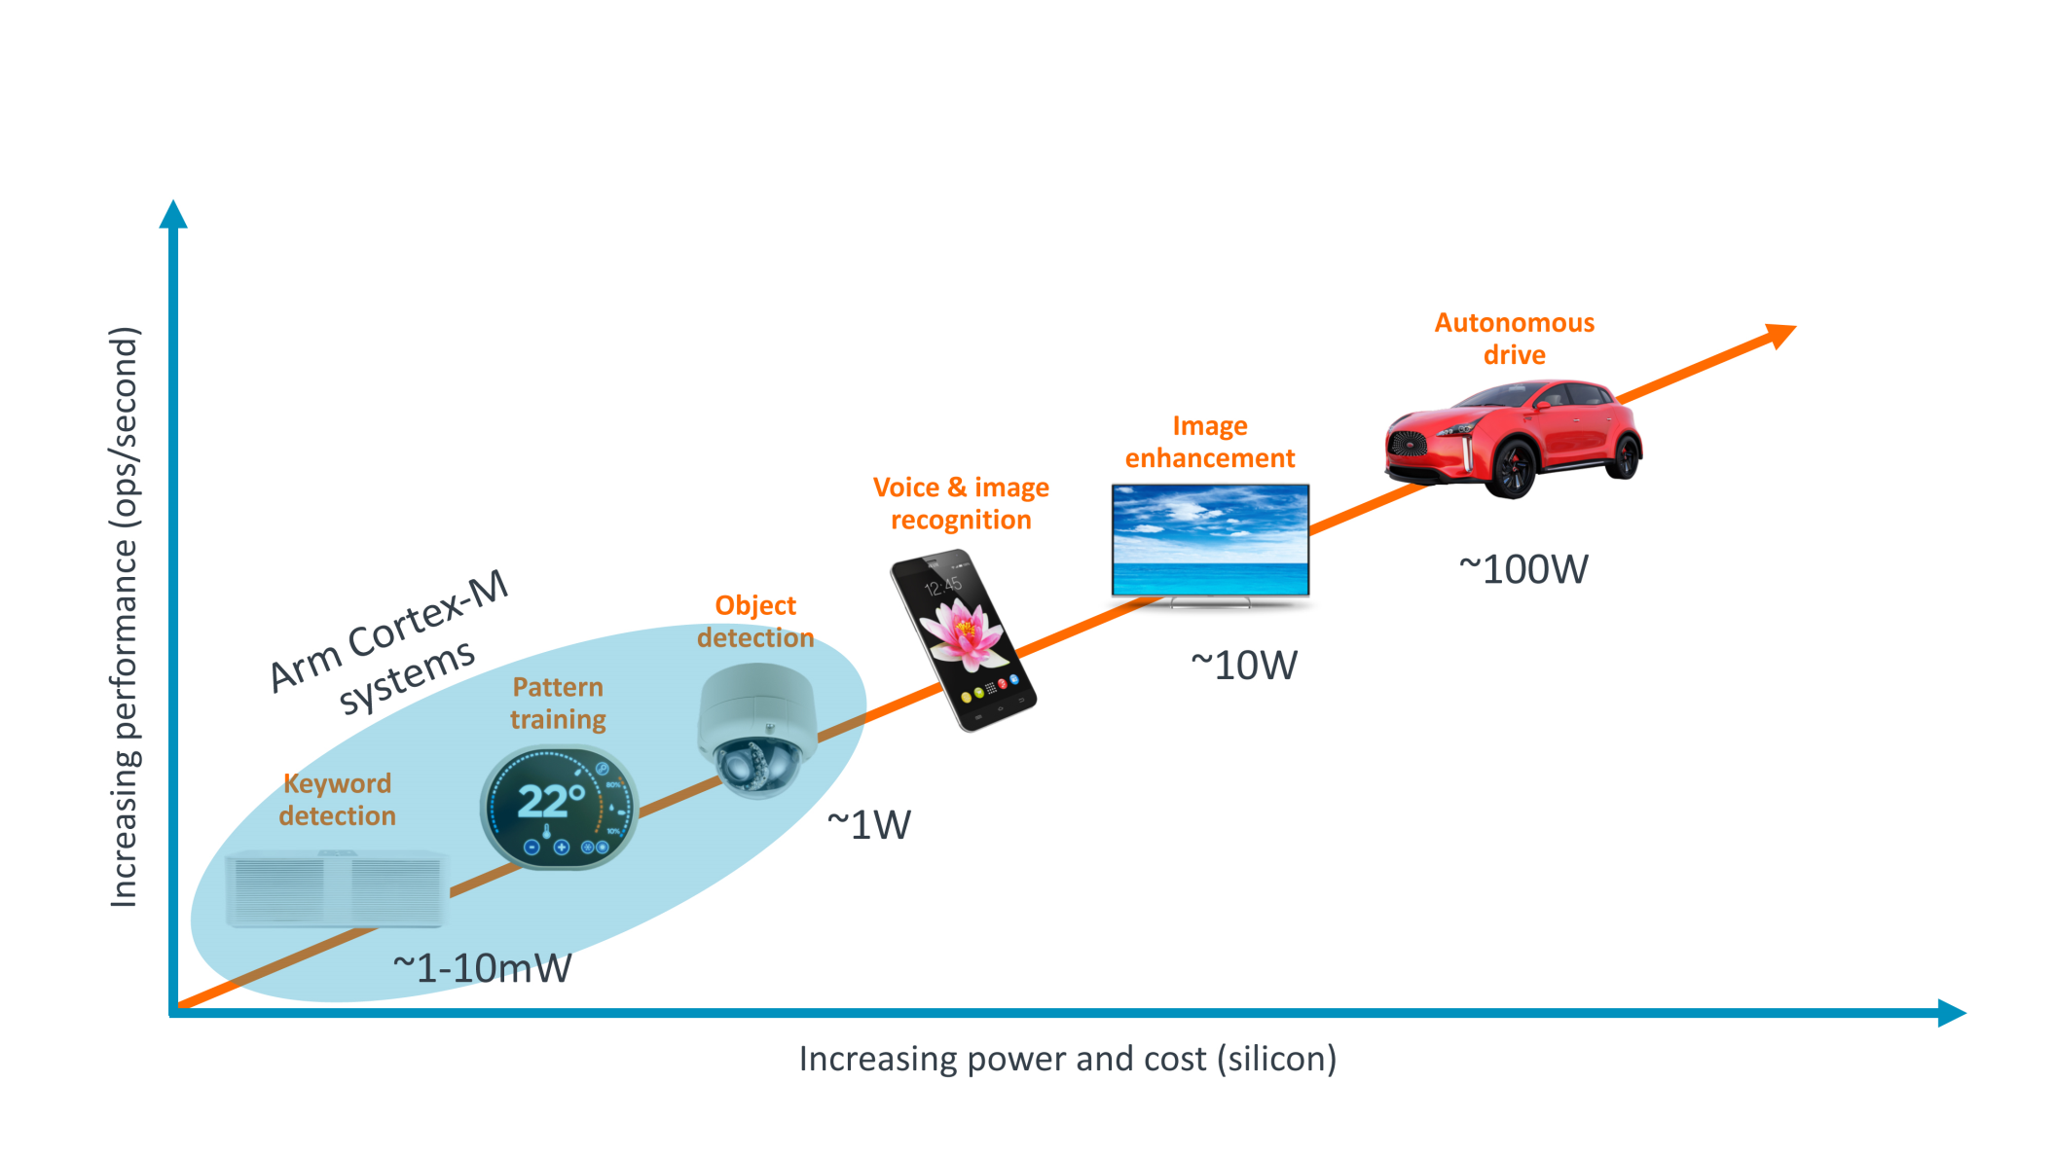
Edge devices and their power budgets
From Vikas Chandra, ARM

Slide 4
Edge Devices
Two factors goes against using cloud based inference solution;
High latency
Security
Inference is much more forgiving than training in terms of precision required
Training is usually done using FP32 where as inference can make do with Int16 or Int8 or even Int4
In edge devices, it is much more important to worry about computational complexity, memory requirement and power usage

Slide 5
Can ARM architecture based processors be the solution?
ARM processors are known to have very good MHz/mW ratio
Range of processors with different processing speeds and memory
Low power requirement makes them ideal for the edge devices which generally run on batteries

Slide 6

Self Initializing, Dynamically expandable & Fault tolerant cluster For Parallel processing
With emphasis on automobile applications
Prepared By: Treepie Computing team
Contact person: Dr. Amit Bhatt
treepie.computing@gmail.com

Slide 7
Problem Definition
To create a self initializing, dynamically expandable, fault tolerant and decentralized cluster which could be used for the automobile segment among other possibilities for parallel computation (HPC)
Goal
To create an automated system to form a cluster with minimum manual intervention.
All boards are capable of becoming a master or slave depending upon the requirement. Any board can become a master by temporarily acquiring services of other boards as slaves depending on its workload.
Allow any board to reserve a certain number of cores for native processes and the rest of the cores would be available for usage by other master boards
Cluster to be fault tolerant to any malfunction in a board

Slide 8
Basic Structure
Server board: The board which is set up when cluster is initialised. Takes care of distributed locking system, file mounting on the cluster and runs a server on a port to carry out essential tasks such as fault tolerance, essential communication with other boards etc.
Master board: Any board which wishes to run its process on the cluster.
Slave: Any board which is used by a master board to run it’s process.

Slide 9
Pre-requisites
General Requirements
Linaro
OpenSSH server and client
Python 2.7
An account with common username and password in all boards
Additional Requirement in Server Board
NFS share support in kernel

Slide 10
Workflow
For easy cluster formation automation is achieved, dependencies are installed and server is made operational using the following python scripts
Setup workflow
Initialise cluster server: On connecting first board Run the following script in terminal by the command
“python cluster_init.py X”
X=0, board made as for the first time. It installs all the dependencies
X=1, when the board has previously been a server i.e. it has all the dependencies installed

Slide 11
Scan for new boards: The server keeps scanning the network continuously to check if a new board has entered the network or an existing board has left.
Initialise new board: To make a new board part of the cluster, simply connect it to the network via an Ethernet cable. The server’s scanner will pick it up and initialise it automatically. As soon as the automatic initialisation is done, the new board can straight away run its processes on the cluster or act as a slave.
Systematic leave: To make a board exit the cluster gracefully, execute the following command from the board’s terminal “python systematic_leave.py”
Systematic leave from the cluster is not mandatory. One can simply power off the board or pull out the LAN cable. The server’s scanner will take care of everything.

Slide 12
Process workflow
Run Program: When a board wants to run an MPI program, run the following command in terminal: “python mstr_wrapper.py X Y” where X is number of slaves required and Y is the path of program file
Request slaves: Board checks if enough slaves are available. If not, the process goes to sleep until enough slaves are available.
Run process: After slaves have been acquired, the MPI process is run on the cluster.
Release slaves: After process is completed, acquired slaves are released so that other masters can use them.

Slide 13
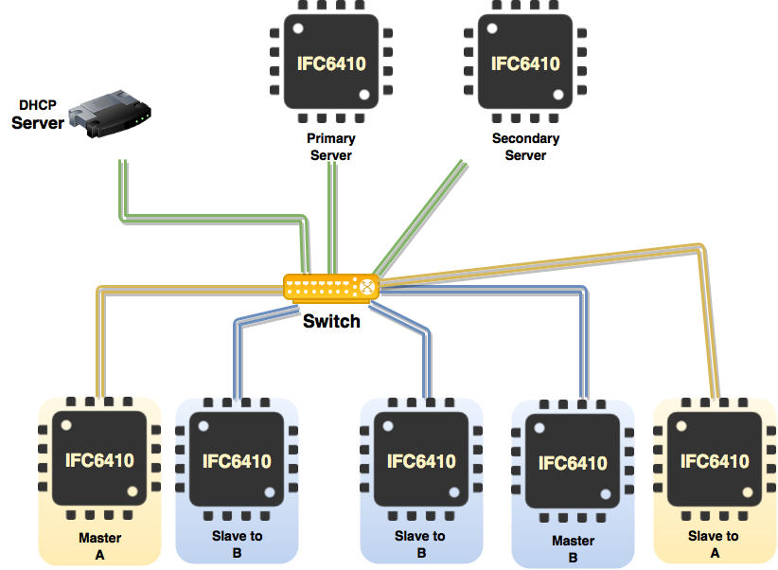
Depiction of a cluster

Slide 14
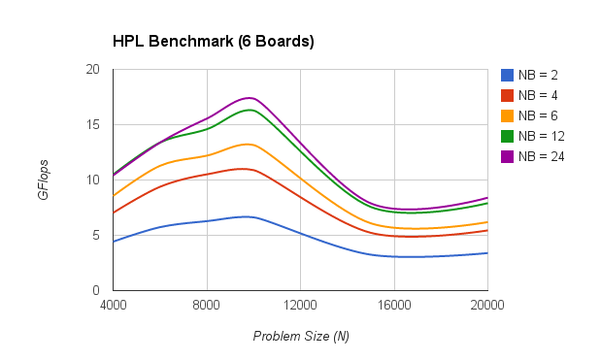
Benchmarking (Compute Intensive Tasks) across Multiple Boards

Slide 15
HPL benchmark with 6 board setup (N = 10000, NB = 24)
Parameter | Results
Performance (X) | 17.5 GFlops
Power (P) | 57.267 W (Peak) | 44.337 (average)
Efficiency (X/P) | 261.93 Mflops/W | 338 Mflops/W
Rank (Estimated) | 294th # | 256^{th #}
# from the recent Green500 list

Slide 16
Tasks carried out continuously in the background
Scripts running on server periodically check for new boards in the cluster if found any initialize it.
Server to respond the request by boards for locks and present number of slaves in cluster.
It also checks if any present board in cluster fails to respond to ping then remove the board from cluster and if the board was master release the slaves acquired by the board.

Slide 17
A mechanism for fault tolerance
The system also efficiently handles fault tolerance. Even cases such as abrupt removal of the board from the network are handled.
The following 3 scenarios come under fault tolerance:
Slave board fails: If a running process terminates unsuccessfully because of the failure of one or more of the slaves, the system makes sure that the process finds new slave(s) to satisfy its initial requirements and restarts the process.

Slide 18
A mechanism for fault tolerance(cont.)
Master board fails: If the board running its process on other slaves itself fails, then the cluster makes sure that the boards which were acting as slaves become free once again so that they can be used by other boards if required.
Server board fails: A deputy board is set up in the cluster. When the main server board fails, this deputy takes over seamlessly as the central entity taking care of the main functionalities of the cluster. This deputy is like any other normal board and can act as slave/master in the cluster on its own. It just has this additional task of checking if the server board has failed so that it can take over and ensure that the cluster keeps functioning.

Slide 19
Fault Tolerant System

Slide 20
Core reservation for native processes
It is possible for any board to reserve a certain number of cores for native processes and the rest of the cores would be available for usage by other master boards
If all the cores of a board are given into the cluster for others to use, the board will fail to deliver on performance of its native processes

Slide 21
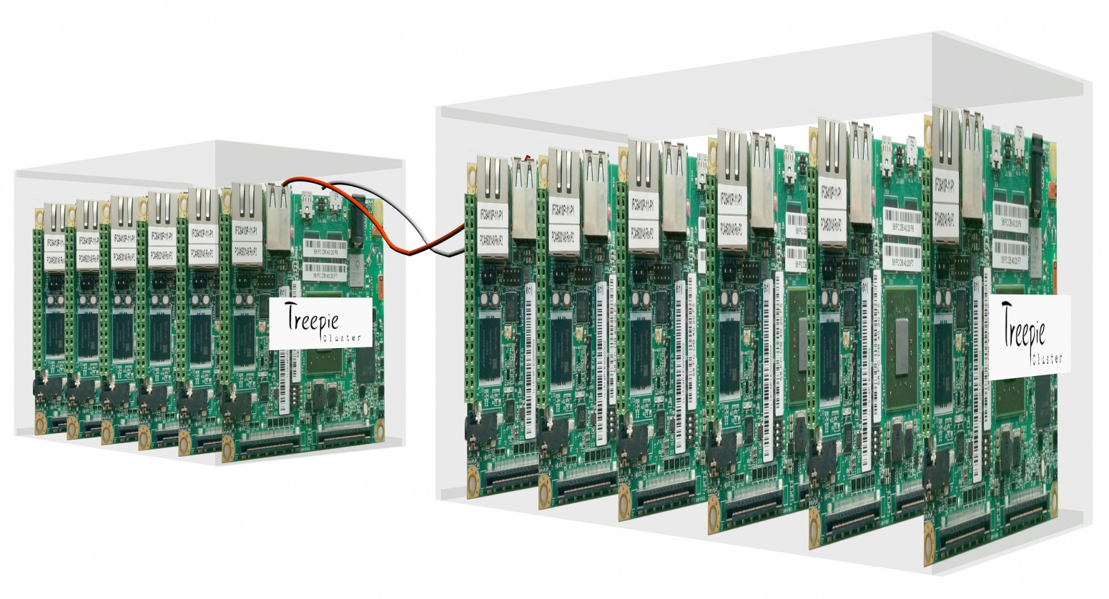
Product Visualization

Slide 22
Edge devices and their power budgets
From Vikas Chandra, ARM

Slide 23
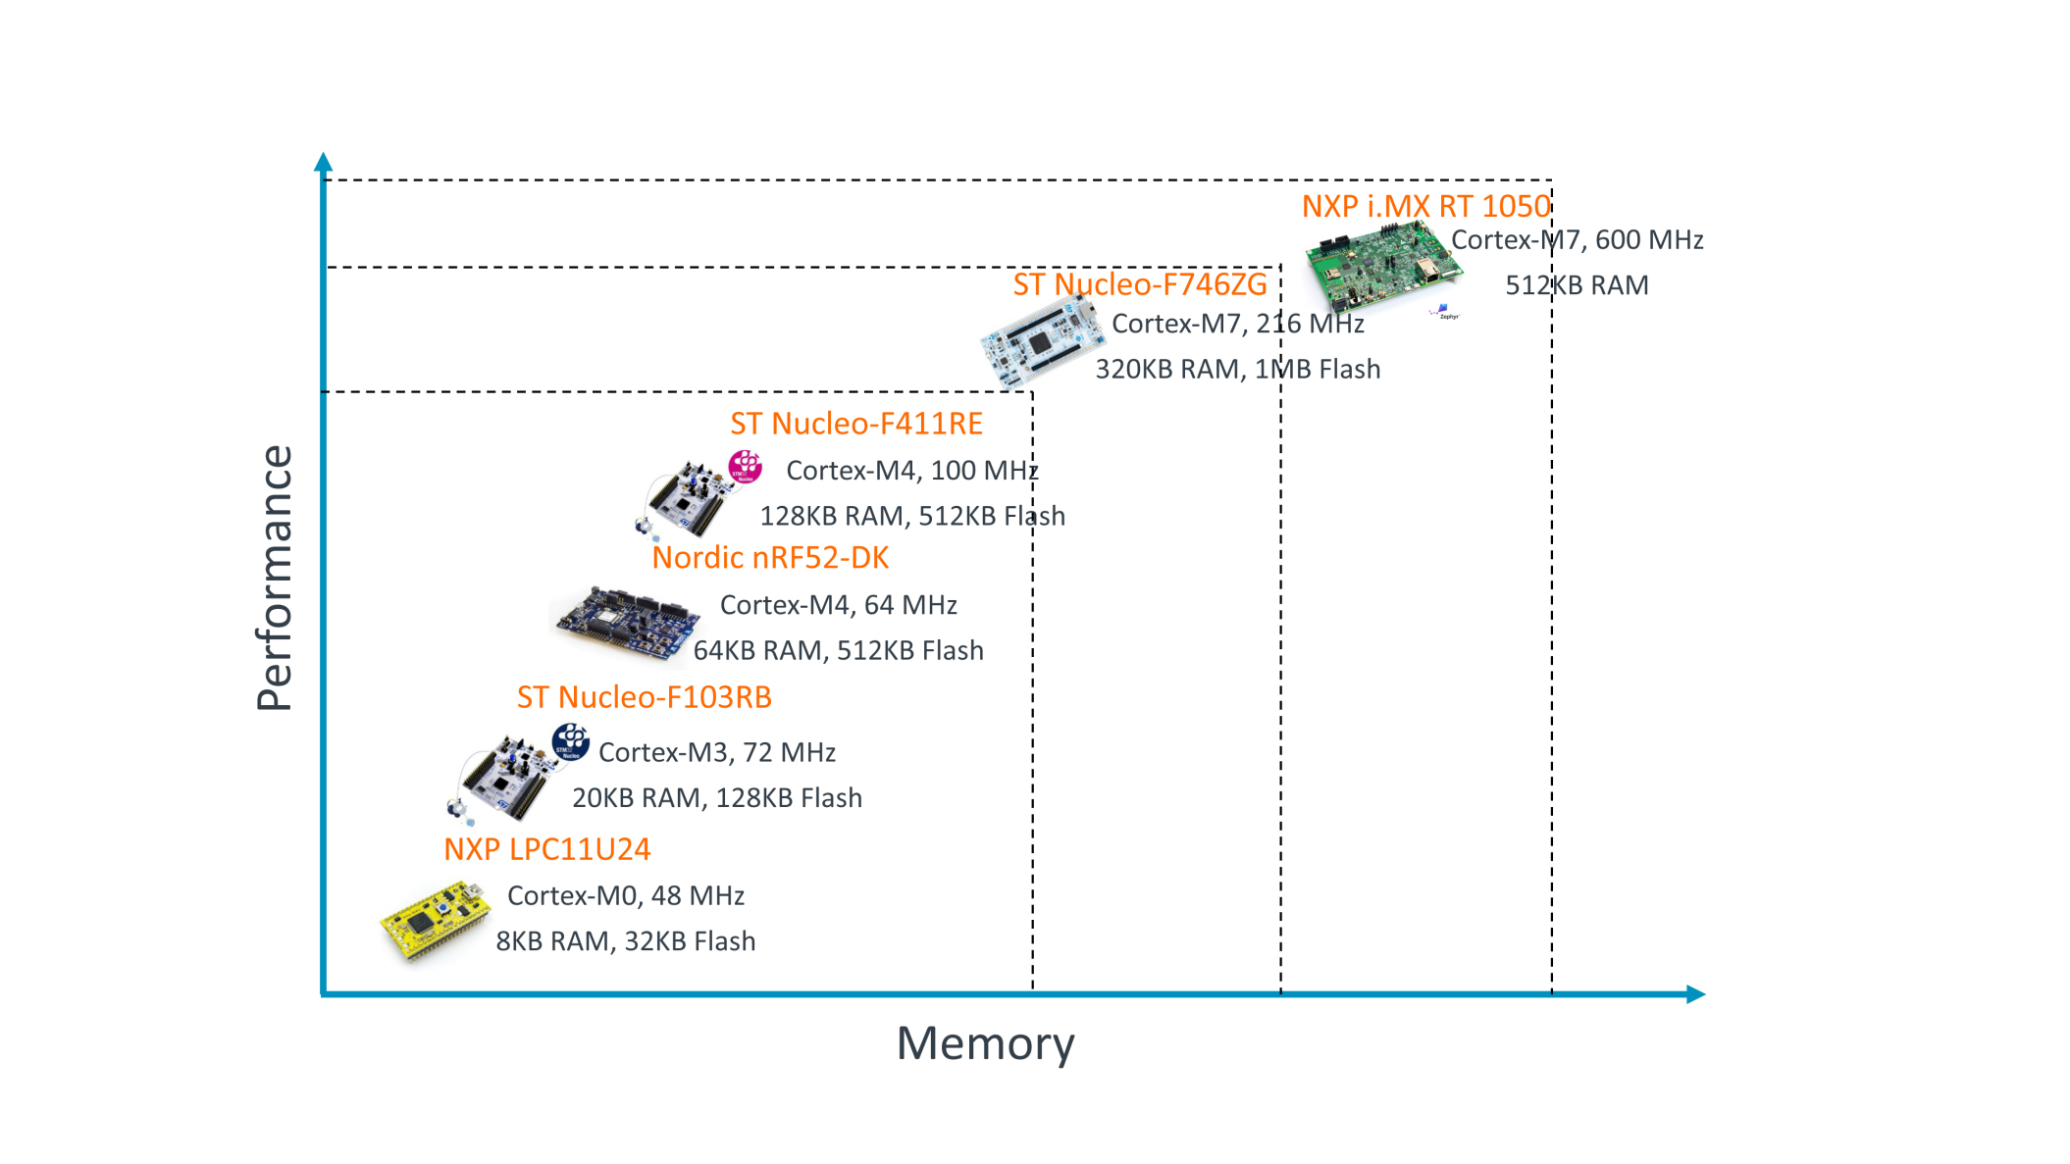
What about devices which requires “little intelligence”?
From Vikas Chandra, ARM

Slide 24
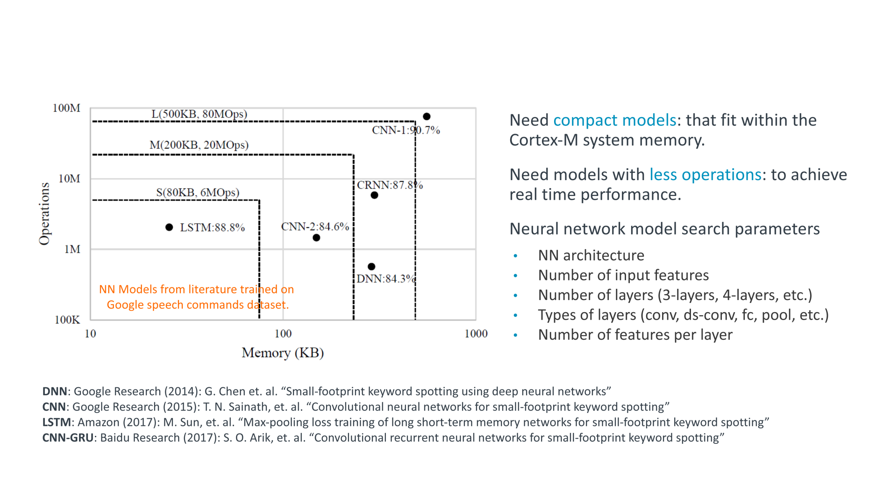
Matching NN models with performance and memory constraints

Slide 25
ARM Helium technology (Feb 20th, 2019)
Advanced digital signal processing (DSP) is available today through Arm Neon technology in richer Cortex-A based devices
Arm also added DSP extensions in its higher performance Cortex-M processors (Cortex-M4, Cortex-M7, Cortex-M33 and Cortex-M35P)
What about smaller Cortex-M processors? Previously they had to depend upon the SoC to use a separate DSP
Armv8.1-M with Helium eliminates these challenges by delivering real-time control code, ML and DSP execution without compromising efficiency
ARM Helium targets three important segments; vibration and motion, voice and sound, and vision and image processing

Slide 26
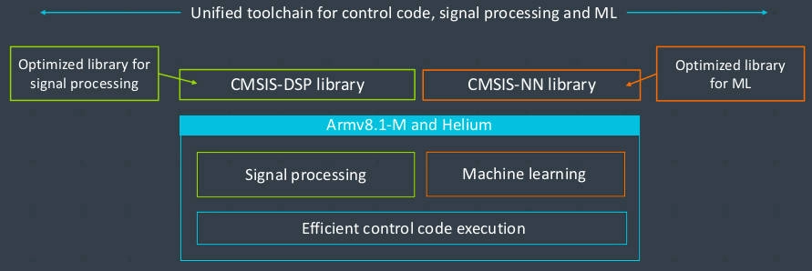
ML and Signal Processing in the same core

Slide 27
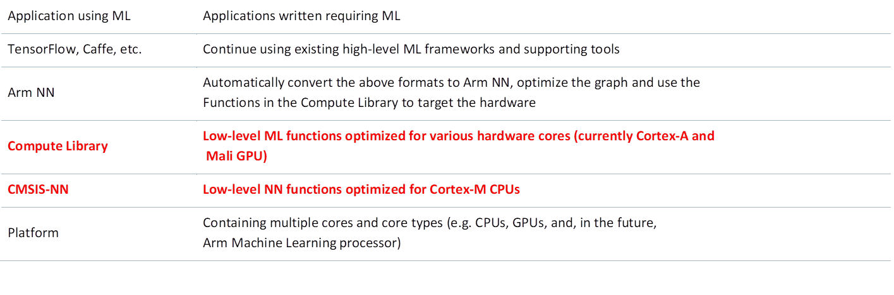
ML flow for Cortex M processors

Slide 28
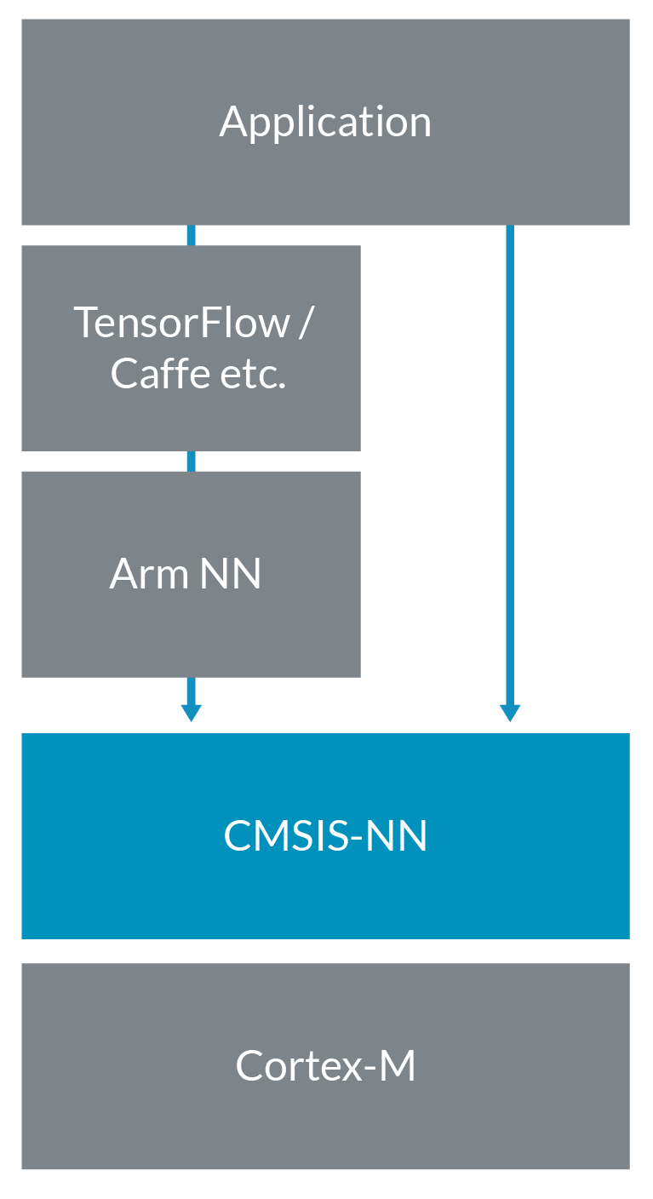
A clearer picture

Slide 29
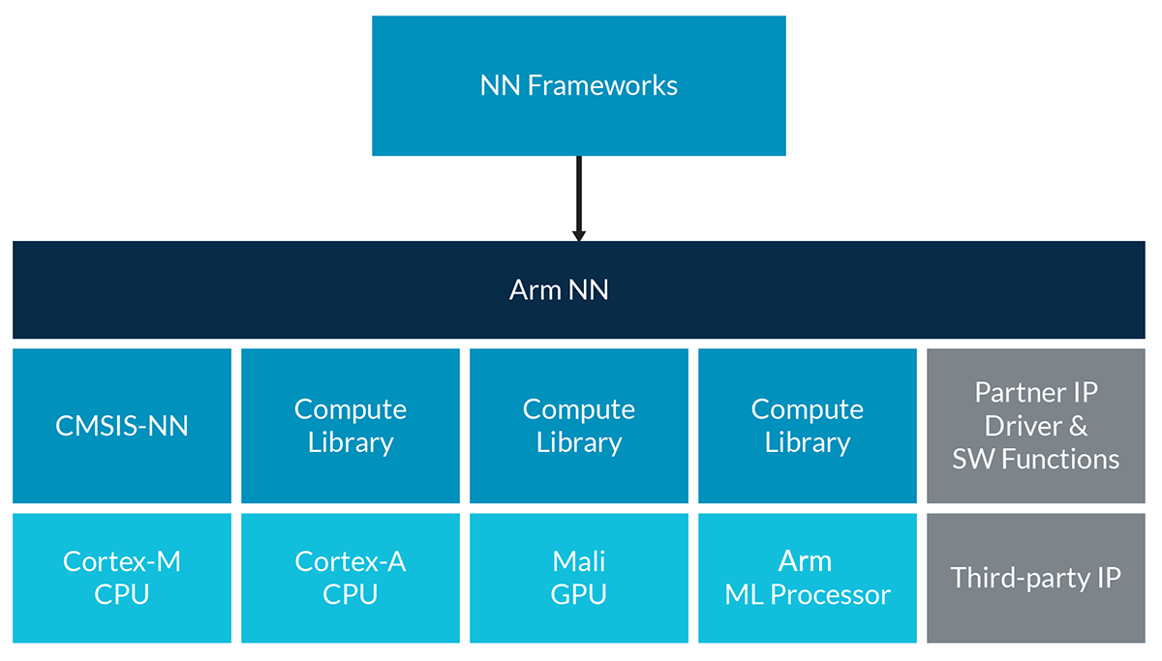
Cortex-M with Vector extension (MVE)

Slide 30
Conclusion
Future is moving towards the edge…
Can we do training and inference on the same platform??
Expect more prevalence of FPGA + CPU + GPU combination
Still too many models, too many frameworks so FPGA might be a good solution till the technology settles

Slide 31
Thank you

